Slide 1
Scientific and Statistical Visualization
Introduction

Slide 2

Michael Eagle, Ph.D.
PostDoc: Carnegie Mellon University
Human-Computer Interaction
PhD: North Carolina State University, Computer Science
M.S. / B.S. : UNC-Charlotte Computer Science
B.A.: UNC-Charlotte, International Studies
Japanese Minor
Industry:
Data Science at Turbine Inc. (WB Games Boston)
Blizzard Entertainment

Slide 3
visualization
pictures
The purpose of computing is insight, not numbers.
Richard Wesley Hamming
Card, Mackinlay, Shneiderman

Slide 4
Banana
Date
Cress
Rice
Sorghum
Brome
M. acuminate
P. dactylifera
Arabidopsis thaliana
Oryza sativa
Sorghum bicolor
Brachypodium distachyon

Slide 5
Venn Diagram
A
B
A & B

Slide 6

vi·su·al·i·za·tion
1. Formation of mental visual images
2. The act or process of interpreting in visual terms or of putting into visible form

Slide 7
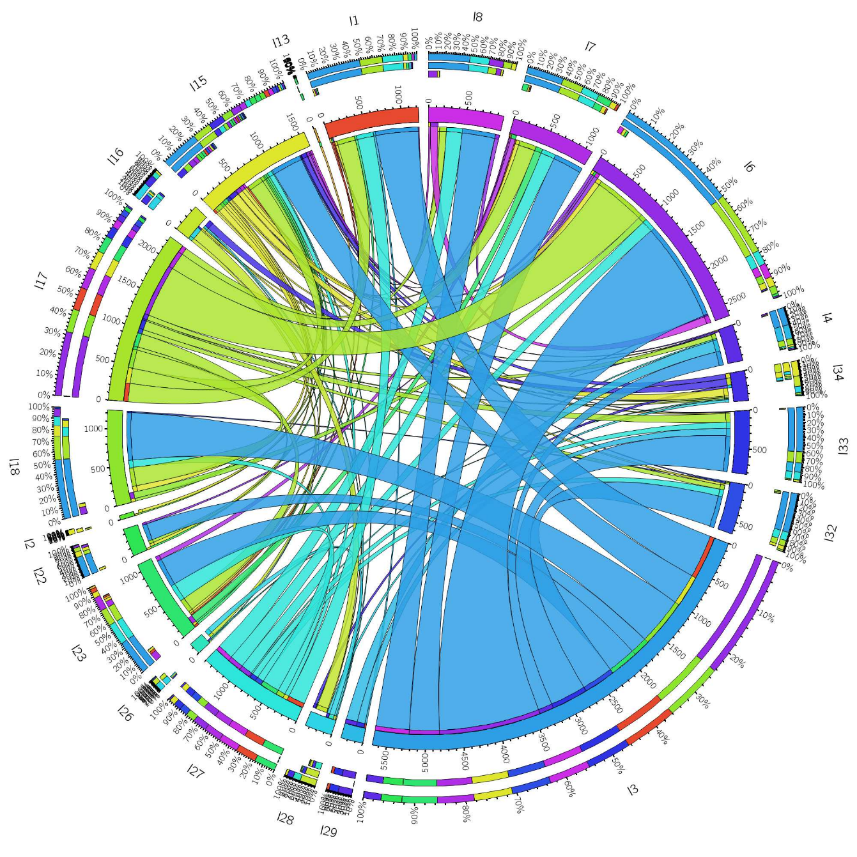
Visualization
Visualization is the process that transforms (abstract) data into interactive graphical representations for the purpose of exploration, conﬁrmation, or presentation.

Slide 8
Good Data Visualization…
Makes Data Accessible
Combines Strengths of humans and computers
Enables insight
Communicates

Slide 9
“Visualization is really about external cognition, that is, how resources outside the mind can be used to boost the cognitive capabilities of the mind.” - Stuart Card

Slide 10
Communication
Why Visualize?
To inform people: Communication
How is X ahead in the election polls?
When questions are not well deﬁned: Exploration
What is the structure of a terrorist network?
Which drug can help patient X?

Slide 11
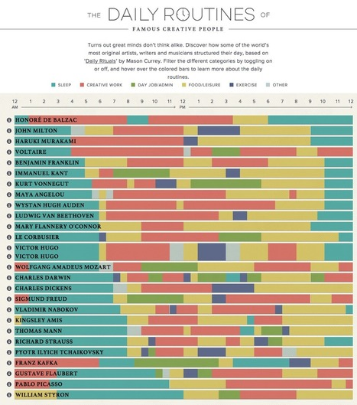
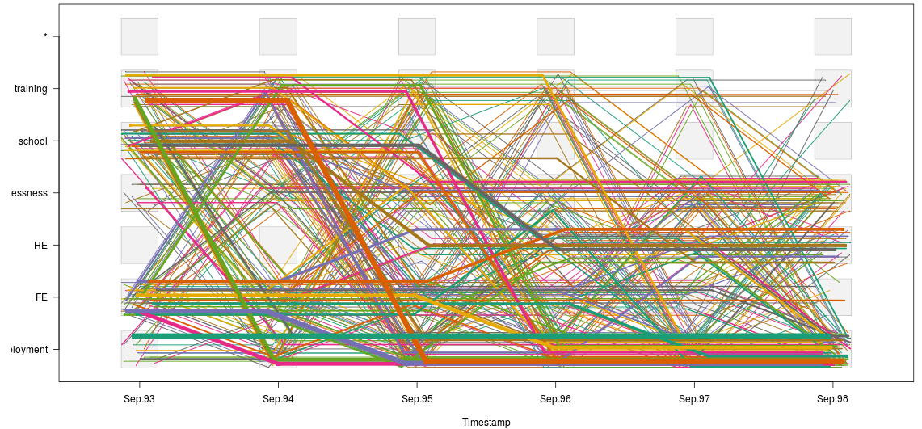
Purpose of Visualization
Open Exploration
Confirmation
Communication

Slide 12
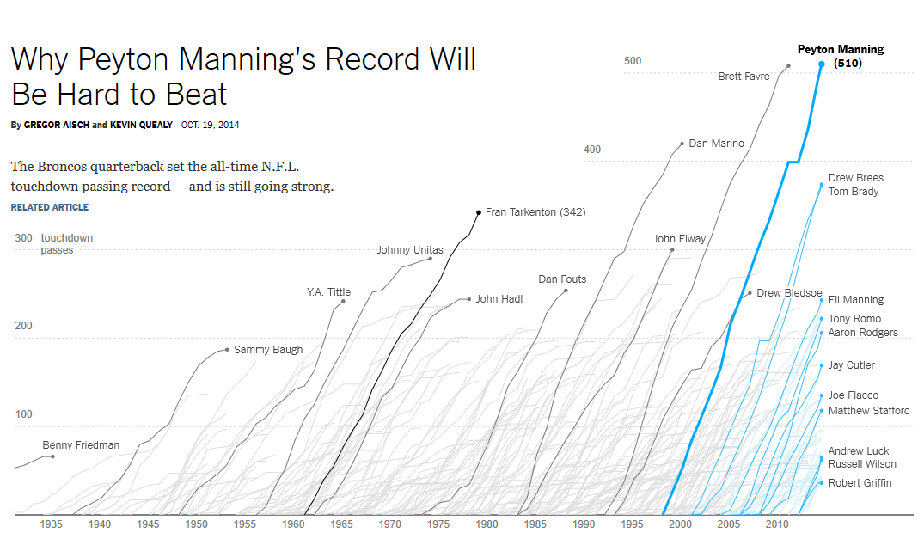
Example: Communication
https://www.nytimes.com/interactive/2014/10/19/upshot/peyton-manning-breaks-touchdown-passing-record.html

Slide 13
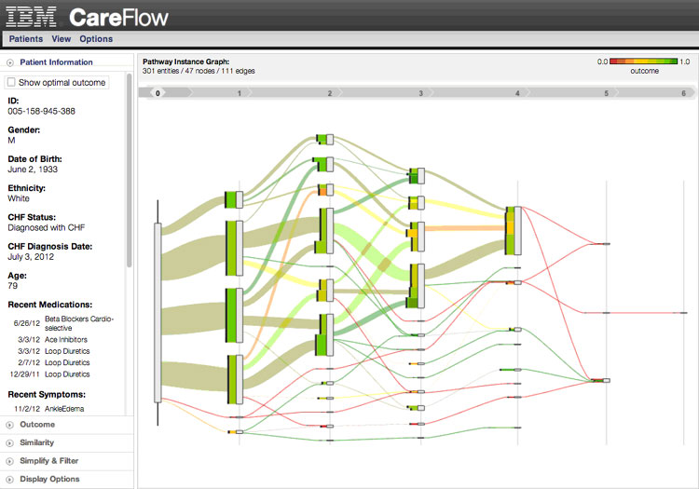
Example: Exploration
https://www.ibm.com/blogs/research/2012/10/data-driven-healthcare-analytics-from-data-to-insight-for-individualized-care/

Slide 14
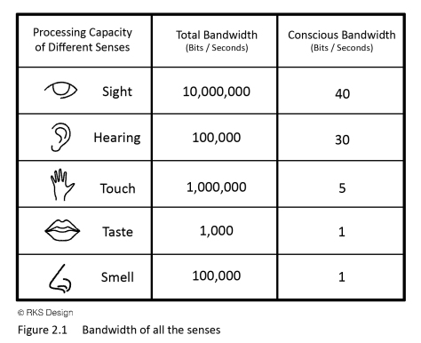
Figures are richer; provide more information with less clutter and in less space.
Figures provide the gestalt effect: they give an overview; make structure more visible.
Figures are more accessible, easier to understand, faster to grasp, more comprehensible, more memorable, more fun, and less formal.
https://www.win.tue.nl/~vanwijk/infovis_springer.pdf

Slide 15
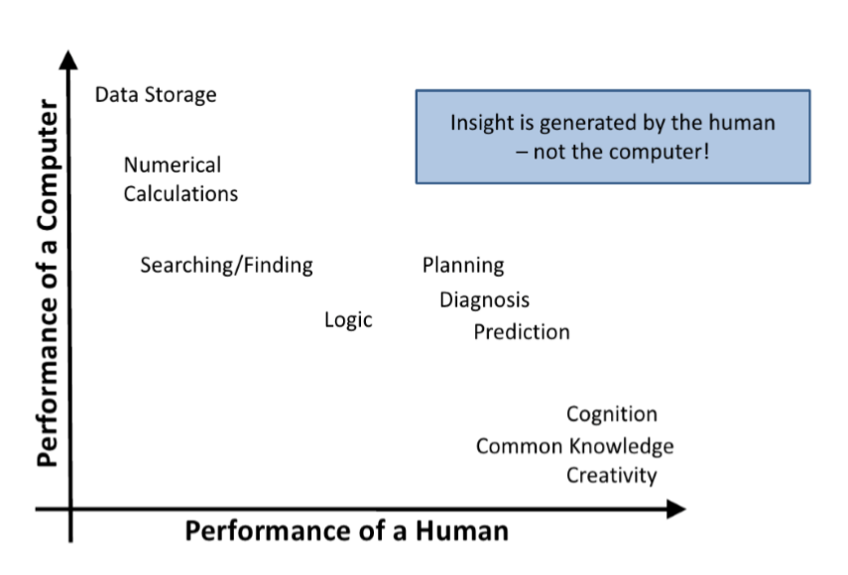
Ability Matrix

Slide 16
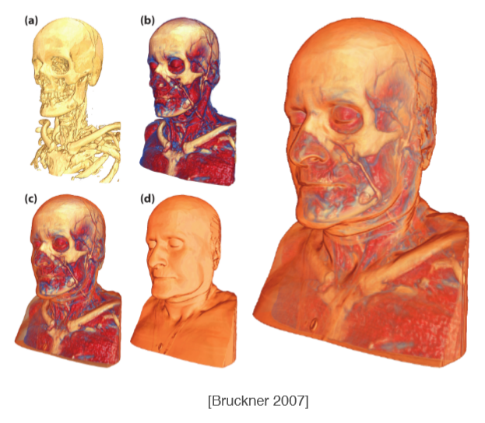
Why Use Computers?
Scale Drawing by hand (or Illustrator)
infeasible
inﬂexible (updates!)
How to draw an MRI scan?

Slide 17
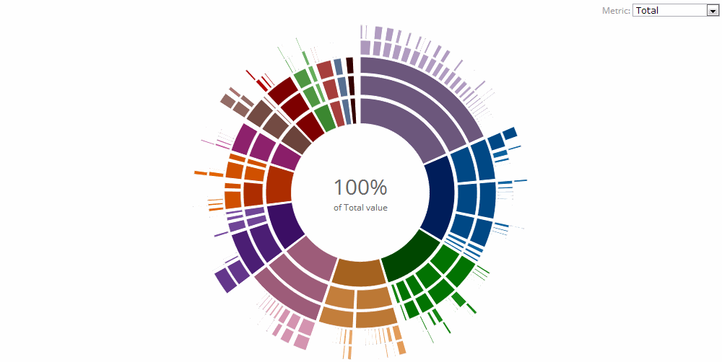
Interactive Visualization
Interaction
Interaction allows to “drill down” into data
Integration
Integration with algorithms
Make visualization part of a data analysis pipeline

Slide 18
Why use Computers?
Efﬁciency
Re-use charts / methods for different datasets
Quality
Precise data driven rendering
Storytelling
Use time

Slide 19
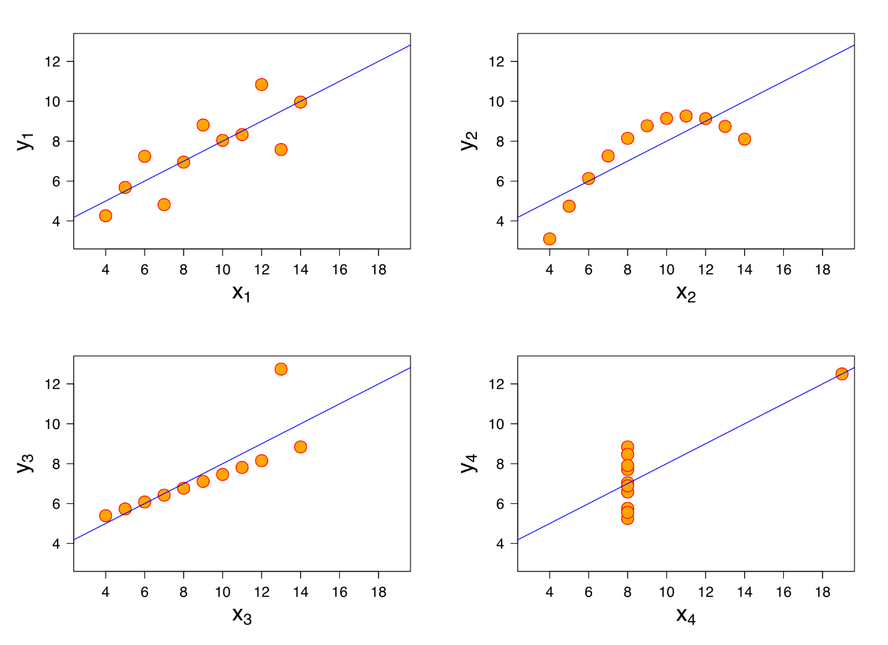
Statistics Only
I |  | II |  | III |  | IV
x | y | x | y | x | y | x | y
10.0 | 8.04 | 10.0 | 9.14 | 10.0 | 7.46 | 8.0 | 6.58
8.0 | 6.95 | 8.0 | 8.14 | 8.0 | 6.77 | 8.0 | 5.76
13.0 | 7.58 | 13.0 | 8.74 | 13.0 | 12.74 | 8.0 | 7.71
9.0 | 8.81 | 9.0 | 8.77 | 9.0 | 7.11 | 8.0 | 8.84
11.0 | 8.33 | 11.0 | 9.26 | 11.0 | 7.81 | 8.0 | 8.47
14.0 | 9.96 | 14.0 | 8.10 | 14.0 | 8.84 | 8.0 | 7.04
6.0 | 7.24 | 6.0 | 6.13 | 6.0 | 6.08 | 8.0 | 5.25
4.0 | 4.26 | 4.0 | 3.10 | 4.0 | 5.39 | 19.0 | 12.50
12.0 | 10.84 | 12.0 | 9.13 | 12.0 | 8.15 | 8.0 | 5.56
7.0 | 4.82 | 7.0 | 7.26 | 7.0 | 6.42 | 8.0 | 7.91
5.0 | 5.68 | 5.0 | 4.74 | 5.0 | 5.73 | 8.0 | 6.89

Slide 20
For whom is this course:
graduate (PhD) students and practitioners
interested to apply data visualization to present their results
What you need to know before:
basics of mathematical analysis, statistics
basics of scientific communication
your application domain’s specific constraints
What you will know after:
overview of data visualization techniques
what makes a good visualization application (design, specificity, …)
pitfalls in visualization design (and how to avoid them)
how to stand out in your work by creating effective visualizations

Slide 21
What is Data Visualization (for)?
Scientific Visualization: “The use of computers or techniques for comprehending data or to extract knowledge from the results of simulations, computations, or measurements” [McCormick et al., 1987]
Information Visualization: “Visualization applied to abstract quantities and relations in order to get insight in the data” [Chi, 2000]
Software Visualization: “Software visualization is concerned with the static or animated 2D or 3D visual representation of information about software systems based on their structure, history, or behavior in order to help software engineering tasks” [Diehl, 2006]
Visual Analytics: “The science of analytical reasoning facilitated by interactive visual interfaces” [Thomas and Cook, 2005]

Slide 22
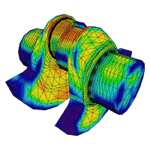
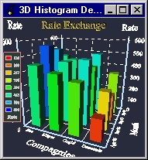
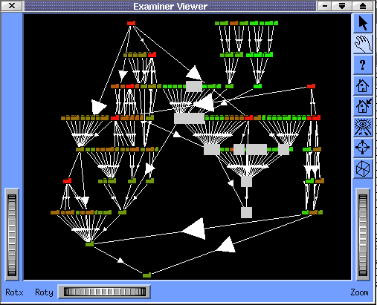
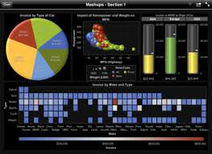
Context of Visualization Subfields
1985
Scientific Visualization: - engineering - geosciences - medicine
1995
Information Visualization: - finance & business - social sciences - e-government
2000
Software Visualization: - the software industry
2005
Visual Analytics
- security & policy
- marketing
- bio/medical sciences

Slide 23
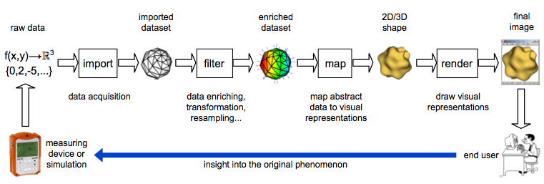
The Visualization Pipeline
transform raw data into insightful answers
sequence of steps
data acquisition (conversion, formatting, cleaning)
data enrichment (transformation, resampling, filtering)
data mapping (produce visible shapes from data)
rendering (draw and interact with the shapes)

Slide 24
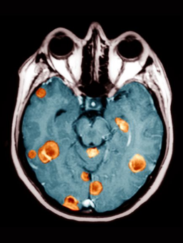
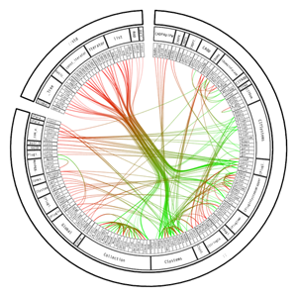
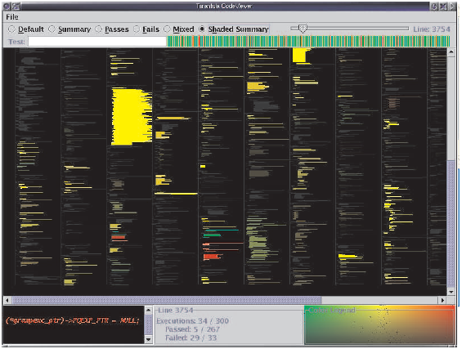
Why is Visualization Useful?
1. Confirm the known:
(in)validate the fit of a given model with a dataset
find the distribution of values over a given domain
find the correlation (or lack thereof) of several variables
answer precise (quantitative) questions
“show an overview of a software system’s quality”
2. Discover the unknown:
find support for a new model in the data
find which model best fits a dataset
find the phenomenon behind the data
answer more vague (qualitative) questions
“which anomalies does this medical image show?”
Quantitative questions:
“which are the strained parts of this car part?”
Qualitative questions:
“is this software system modular or spaghetti code?”
Code colored by test reports
Color coded MRI with tumor
Strain colored car part
Software call graph

Slide 25
When is visualization useful?
1. Too much data:
do not have time to analyze it all (or read the analysis results)
show an overview, discover which questions are relevant
refine search either visually or analytically
2. Qualitative / complex questions:
cannot capture question compactly/exactly in a query
question/goal is inherently qualitative: understand what is going on
show an overview, answer the question by seeing relevant patterns
3. Communication:
transfer results to different (non technical) stakeholders
learn about a new domain or problem

Slide 26
When is visualization NOT useful?
1. Queries:
if a question can be answered by a compact, precise query, why visualize?
“what is the largest value of a set?”
2. Automatic decision-making:
if a decision can be automated, why use a human in the loop?
“how to optimize a numerical simulation?”
Key thing to remember:
visualization is mainly a cost vs benefits (or value vs waste) proposal
cost: effort to create and interpret the images
benefits: problem solved by interpreting the images
similar discussion in software engineering: lean development [Poppendieck 2006]
✗ B. Lorensen, On the Death of Visualization, Proc. NIH/NSF Fall Workshop on Visualization Research Challenges, 2004
✗ S. Charters, N. Thomas, M. Munro, The end of the line for Software Visualisation? Proc. IEEE VISSOFT, 2003
✗ S. Reiss, The paradox of software visualization, Proc. IEEE VISSOFT, 2005
✓J. J. van Wijk, The Value of Visualization, Proc. IEEE Visualization, 2005
M. Poppendieck, T. Poppendieck, Lean Software Development, Addison-Wesley, 2006

Slide 27
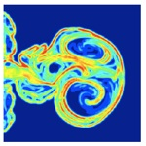
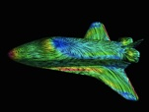
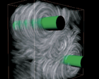
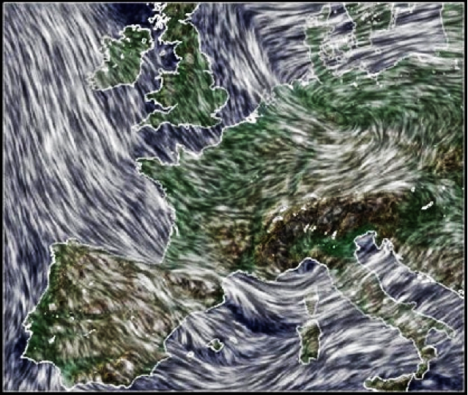
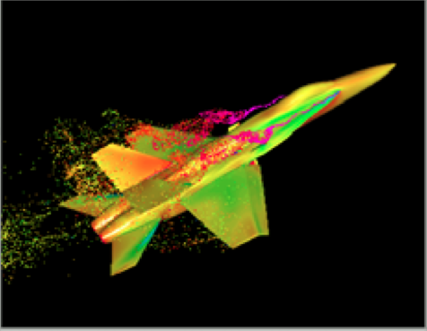
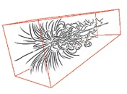
Visualization examples: Engineering sciences
mixing of substances
(chemistry)
flow on surface
(aircraft design)
flow in volume
(engine design)
wind flow atop geo map
(weather forecast)
particle flow close to surface
(aircraft design 2)
sketch of flow in volume
(illustrative/communication)

Slide 28
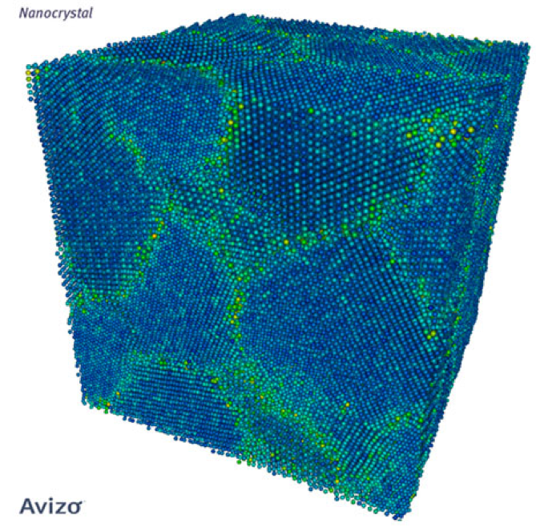
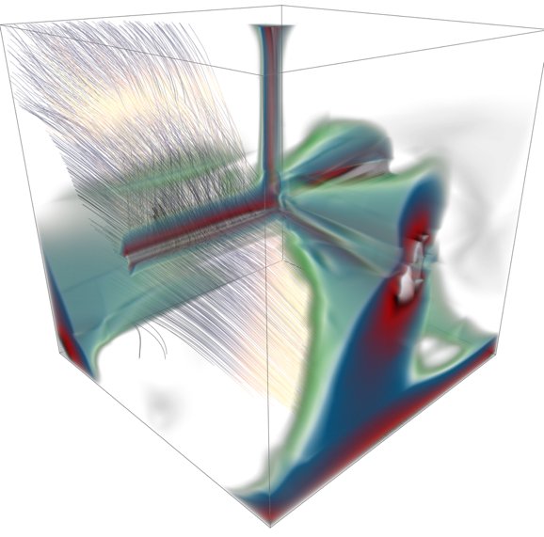
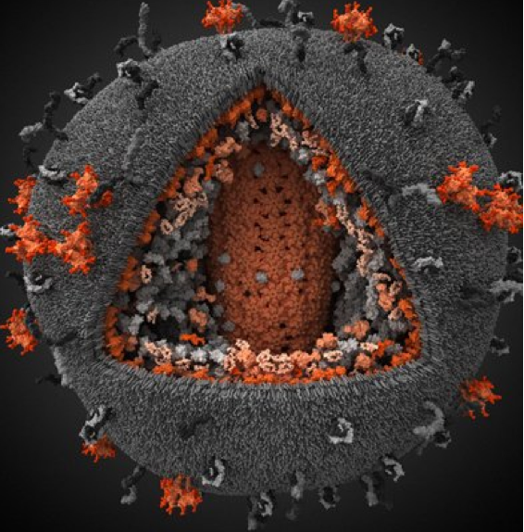
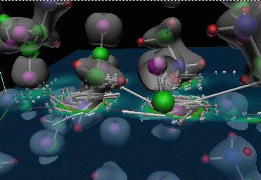
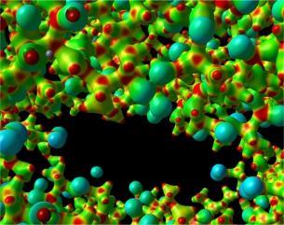
Visualization examples: Material/biosciences
atoms in crystal
(crystallography)
stress tensors
3D HIV model
glycine crystal simulation
potential field in crystal structure

Slide 29
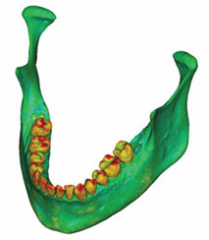
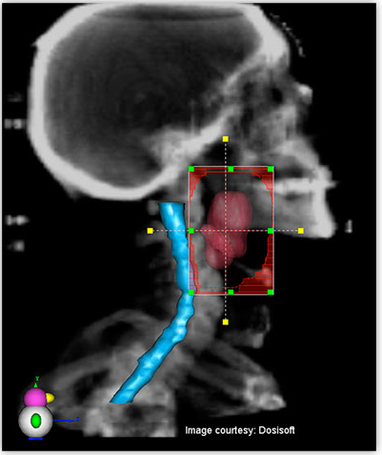
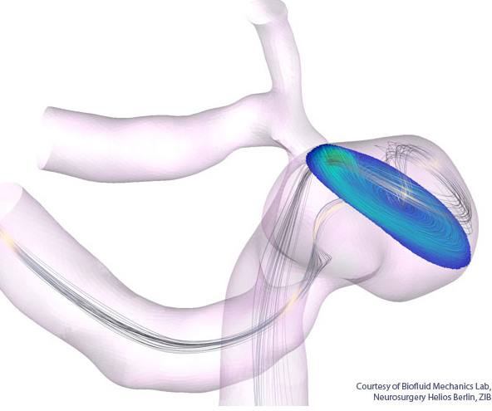
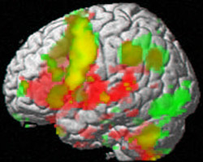
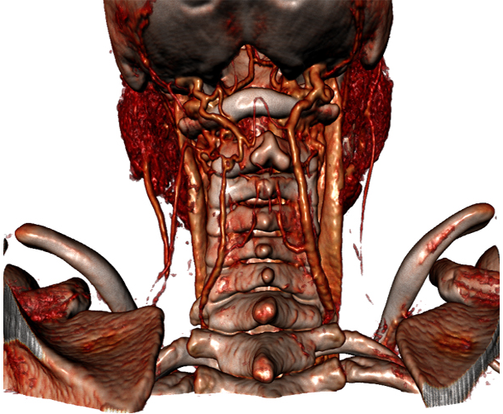
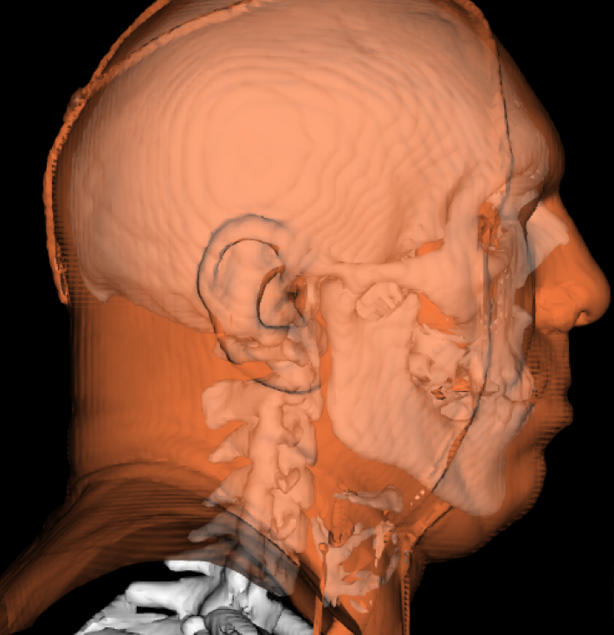
Visualization examples: Medical sciences
surgery planning
blood flow in aneurysm
bone tissue density
brain activity (fMRI)
MRI scan - tissues
bone + skin surface

Slide 30
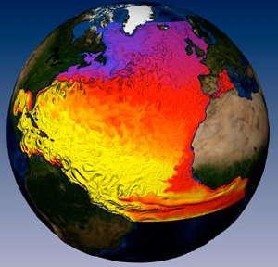
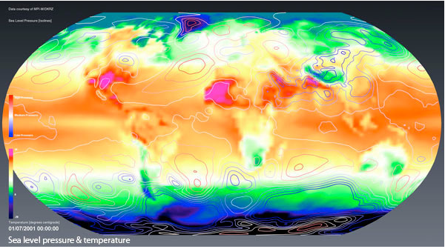
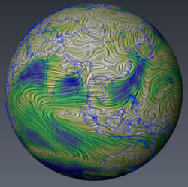
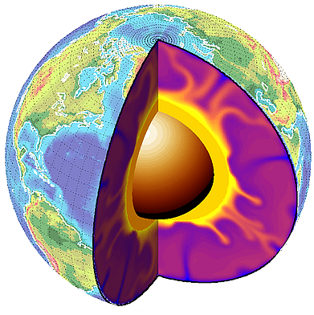
Visualization examples: Geosciences
ocean velocity
and surface temperature
sea level pressure and temperature
wind flow paths over Earth’s surface
Earth surface and inner temperature

Slide 31
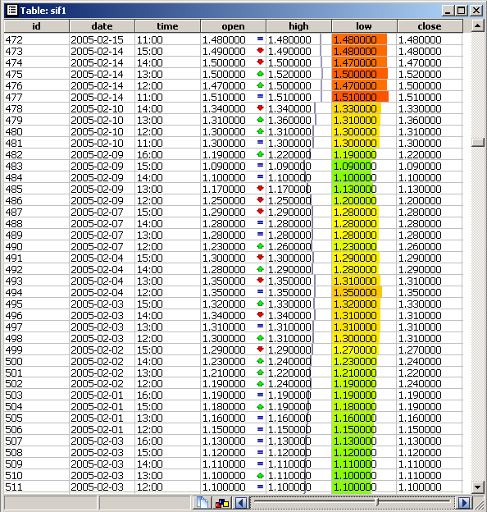
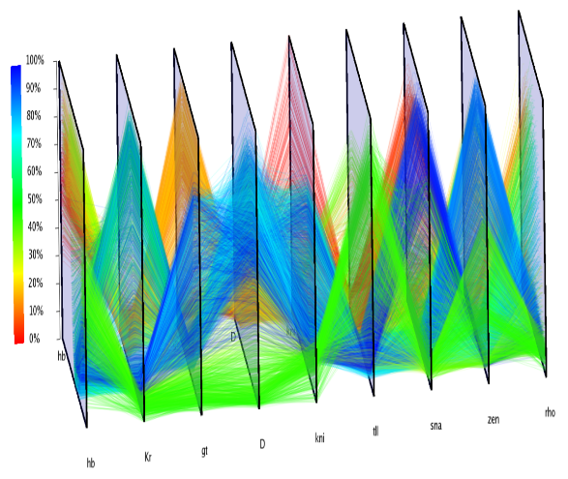
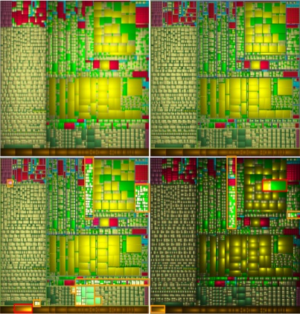
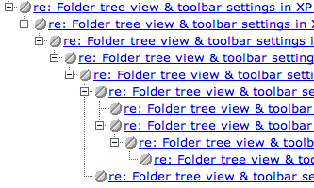
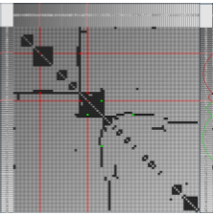
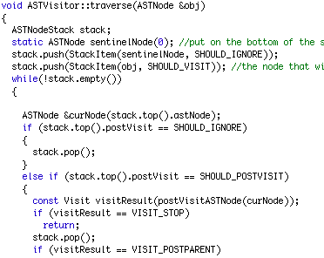
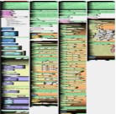
Visualization examples: Abstract data
mapping is not ‘neutral’ or natural, but reflects the problem/question to be solved
data table: classical view
data table: parallel coordinates view
tree: explorer view
tree: cushion treemap view
source code: classical view
source code: dense pixel view
graph: bundled view
graph: adjacency matrix

Slide 32
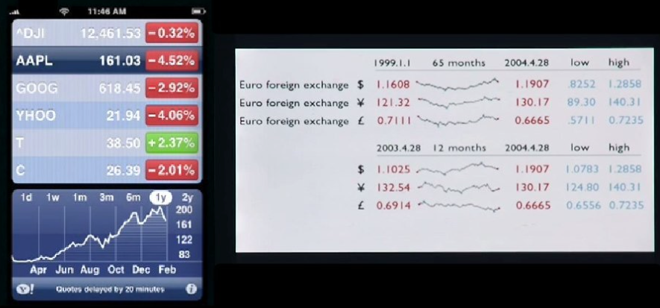
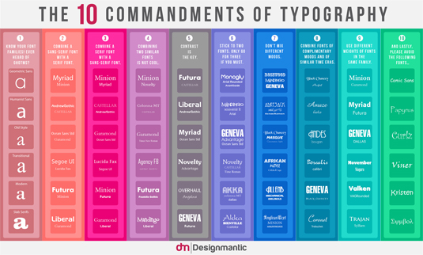
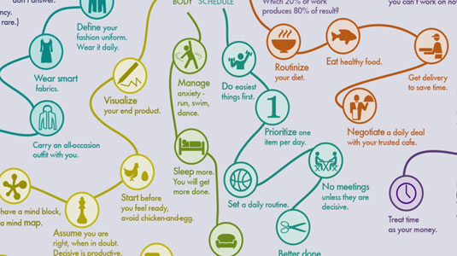
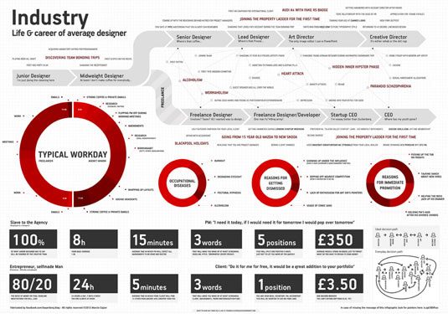





Visualization examples: Infographics
basically information visualization displays, carefully set into (artistic) graphic design
time series
categorical trees
path lines
time lines
density maps
graphs and networks
more graphs and networks
multivariate data
stacked bar charts

Slide 33

SciVis vs InfoVis vs Infographics
SciVis
InfoVis
Infographics
high scientific content
very technical audience
typically interactive
very precise information
high level of detail
less scientific content
less technical audience
typically interactive
less precise information
more aggregation
general-purpose content
very broad audience
typically static
qualitative information
summaries

Slide 34


Scientific Visualization – Basic data Characteristics
Stanford bunny 3D model (70K triangles, 30K vertices)
Right image shows surface curvature (scalar dataset, red=flat, blue=curved)
data: numerical values defined on a spatial domain, say: f : R³ → R
both domain and range are continuous spaces
hence the following are easy
resampling / rescaling
filtering
reconstruction (from piecewise discrete representation e.g. triangles)
visual interpretation (domain is a natural 3D shape)

Slide 35
Scientific Visualization – The Dataset
Dataset
key notion in visualization (SciVis, InfoVis, SoftVis)
a dataset captures all relevant characteristics of a data collection
structure
data values
data operations
m-dimensional
n-variate
Dataset
f : R^{m} → R^{n}
Structure
f : R^{m} → R^{n}
Attributes
f : R^{m} → R^{n}
Operations
f : R^{m} → R^{n}
Points
Cells
Scalar
Vector
Tensor
…
Reconstruction
…
f : R² → R^{n}
f : R^{m} → R
f : R^{m} → R³
f : R^{m} → R^{6..9}
piecewise constant
piecewise linear
f : R³ → R^{n}
We’ll detail all these later

Slide 36




Our input: Dataset examples
f : R² → R
f : R³ → R
a planar slice
a volume
f : R² → R⁰
f : R² → R
a surface
a surface
with curvature data

Slide 37


Our output: The image
domain: 2D space (the pixel positions)
co-domain: the pixel (RGB) colors or grayscale values
color image
grayscale image
f : R² → R³
f : R² → R⁺

Slide 38

Functional view on visualization
input: dataset in high-dimensional space d ⊆ D^{m x n}
output: color image i ⊆ R^{2 x 3} = R⁵
visualization: function v : D^{m} → R⁵ (from data to images)
analysis: inverse function v⁻¹ : D^{m} → R⁵ (from images to data)

Slide 39
Visualization Challenges
Dimensionality
input dataset typically of much higher dimensionality than 2D images (m+n>>2+3)
where to put all those dimensions?
Data size
input number of data points much higher than screen resolution
where to draw all those data points?
Analysis
visualization function not (fully) invertible
how to go from shapes/colors back to data?
Example
v : D⁴ → R⁵
f : R³ → R
??
color image
a volume

Slide 40
Simple Solutions
filtering
mapping
planar slice
extract slice
f : R² → R
draw slice
map f to colors
data volume f : R³ → R
filtering
mapping
surface
extract
surface
f : R² → R⁰
draw surface

Slide 41

More complex cases
f : R³ → R^{n>>1}
Multi-variate data
where to draw all those n data values?
f (x,y,z) = (f₁,…, f_{n})
f : R^{m>>3} → R
Multi-dimensional data
where to draw all those m dimensions in a 2D image?
Non-spatial data
f : D → C D, C are not subsets of R^{k}
graphs, trees, databases, text documents, …
how to map D, C to image attributes (positions, color)?

Slide 42

Visualization challenges (cont’d)
How to make the visualization function v invertible?
Data values mapped to RGB colors via a colormap
Invert mapping:
look at some point (x,y) in the image→ color c
locate c in colormap at some position p
use the colormap legend to derive data value s from p
x,y
blue=0
red=100
p
answer: s = 90
Problems
what if we cannot distinguish colors well? (step 1)
what if we cannot compare colors well? (step 2)
what if the colormap is bad? (step 3, e.g. more values s₁, s₂ map to same color c)
what if there’s no color legend?
what if there’s no colormap?
…

Slide 43
Information Visualization – Data Characteristics
Tables Text
Graphs and trees Relational databases
data is not defined on a spatial domain! f : R^{n} → R^{m}
data is not always numerical f : R^{n} → R^{m}
data is inherently discrete!
no natural resampling, interpolation, reconstruction
data structure is not a sampling artifact but a first-class property
relations (hierarchy, associations)

Slide 44
Information Visualization – Attributes
SciVis data typically numerical (R^{m})
InfoVis data attributes can be of different types
type
operations
examples
categorical⁽¹⁾
==,!=
file type
less
general
ordinal
above, <,>
strings
InfoVis data
discrete
above, +,-
#persons
continuous
above, *,/
voltage
SciVis data
more
general
¹ relations can be seen as ordered pairs of categorical attributes
to do interpolation/resampling, we need
continuous attributes (f : R^{n} → R^{m})
defined on a continuous space with metric properties (f : R^{n} → R^{m})
typical InfoVis attributes do not satisfy the above
hence some inherent difficulties

Slide 45

Information Visualization – Attributes (cont’d)
Attribute type examples
Visual encoding examples

Slide 46


Information Visualization – Pipeline Characteristics
recall the visualization pipeline:
1. Filtering:
natural for SciVis data (sampling/reconstruction theory)
hard for InfoVis data (problem/dataset specific)
2. Mapping:
natural for SciVis data (draw values on given 2D/3D domain)
explicit design decision for InfoVis data (draw values on chosen domain)
choose a spatial domain
encode some values → space attributes (layout)
encode other values → color/texture/shading
subsample
subsample
?
?
?
bone dataset, 80K points
bone dataset, 20K points
C++ text, 80K lines
C++ text, 20K lines

Slide 47


Information Visualization – Filtering
Resampling: why is this such an important issue?
subsample
bone dataset, 80K points
bone dataset, 20K points
we throw away 75% of the data
the semantics stays the same (a bone)
subsample
program, 6 LOC, 88 chars
program, 6 LOC, 87 chars
we throw away one single character
the semantics becomes completely different
Note on resampling:
SciVis: Cauchy continuous ☺
InfoVis: highly discontinuous ☹

Slide 48
Summary
Data Visualization
helps getting insight into large, multidimensional, multivariate datasets
visualization pipeline
data acquisition, filtering, mapping, and rendering
visualization sub-fields
scientific visualization
information visualization
visualization challenges
data encoding
inverse mapping
attribute types
continuous, discrete, ordinal, categorical
Next module
data representation
Happy so far?

Slide 49





Further reading
Data Visualization – Principles and practice (A. Telea, CRC Press, 2014)
main focus: scientific visualization
for visualization designers (programmers) and researchers
Visualization Analysis and Design (T. Munzner, CRC Press, 2014)
main focus: information visualization
for visualization designers (programmers) and researchers
Information Visualization: Perception for Design (C. Ware, Morgan Kaufman, 2012)
main focus: information visualization, infographics
for visualization designers (programmers) end-user scientists
The Visual Display of Quantitative Information (E. Tufte, Graphics Press, 2001)
main focus: information visualization, infographics
for visualization designers and graphics artists
Show Me the Numbers – Designing Tables and Graphs (S. Few, Analytic Press, 2012)
main focus: information visualization, infographics
for visualization designers and graphics artists

